Slide 1


Slide 2
World Language Day ECIS Teacher Conference:
Refocus & Rethinking
London,England
November 3, 2022

Slide 3
AERO Curriculum Design Project
Dr. Christine Brown
Regional Education Officer
US Department of State

Slide 4

AERO World Language Standards
Started in 2005- Led by ACTFL-Standards Writing Task Force Chair C. Brown
Task Force organized by the Office of Overseas Schools
11 Member Team-C Brown and 9 WL Educators and one principal
Based on US Language (ACTFL)Standards with Benchmarks Internationalized
K-12 sequences initially- recent revision including shorter sequences

Slide 5
WL Standards Cont.
Standards Based Unit Design and Assessment Design based on US Foreign Service Scale
Alignment with other paradigms- Common European Framework, Standards from other nations
Creation of the Tier 2 WL Project to build on AERO WL Summer Institutes to expand expertise in International Schools
Creation of the Tier 2 WL Model Curriculum based on AERO Standards, Benchmarks, and Essential Questions derived from a program in the US- Glastonbury, CT
AERO Tier 1 and Tier 2 and intersections culminate in pilots in many international schools and the presentations today

Slide 6

US, ACTFL, and AERO Standards based on the 5 C’s

Slide 7
WHY IS UNDERSTANDING BY DESIGN THE IDEAL CURRICULUM DESIGN TOOL FOR LANUAGE UNITS?
STARTING WITH THE END IN MIND!
Great assessments drive instruction

Slide 8
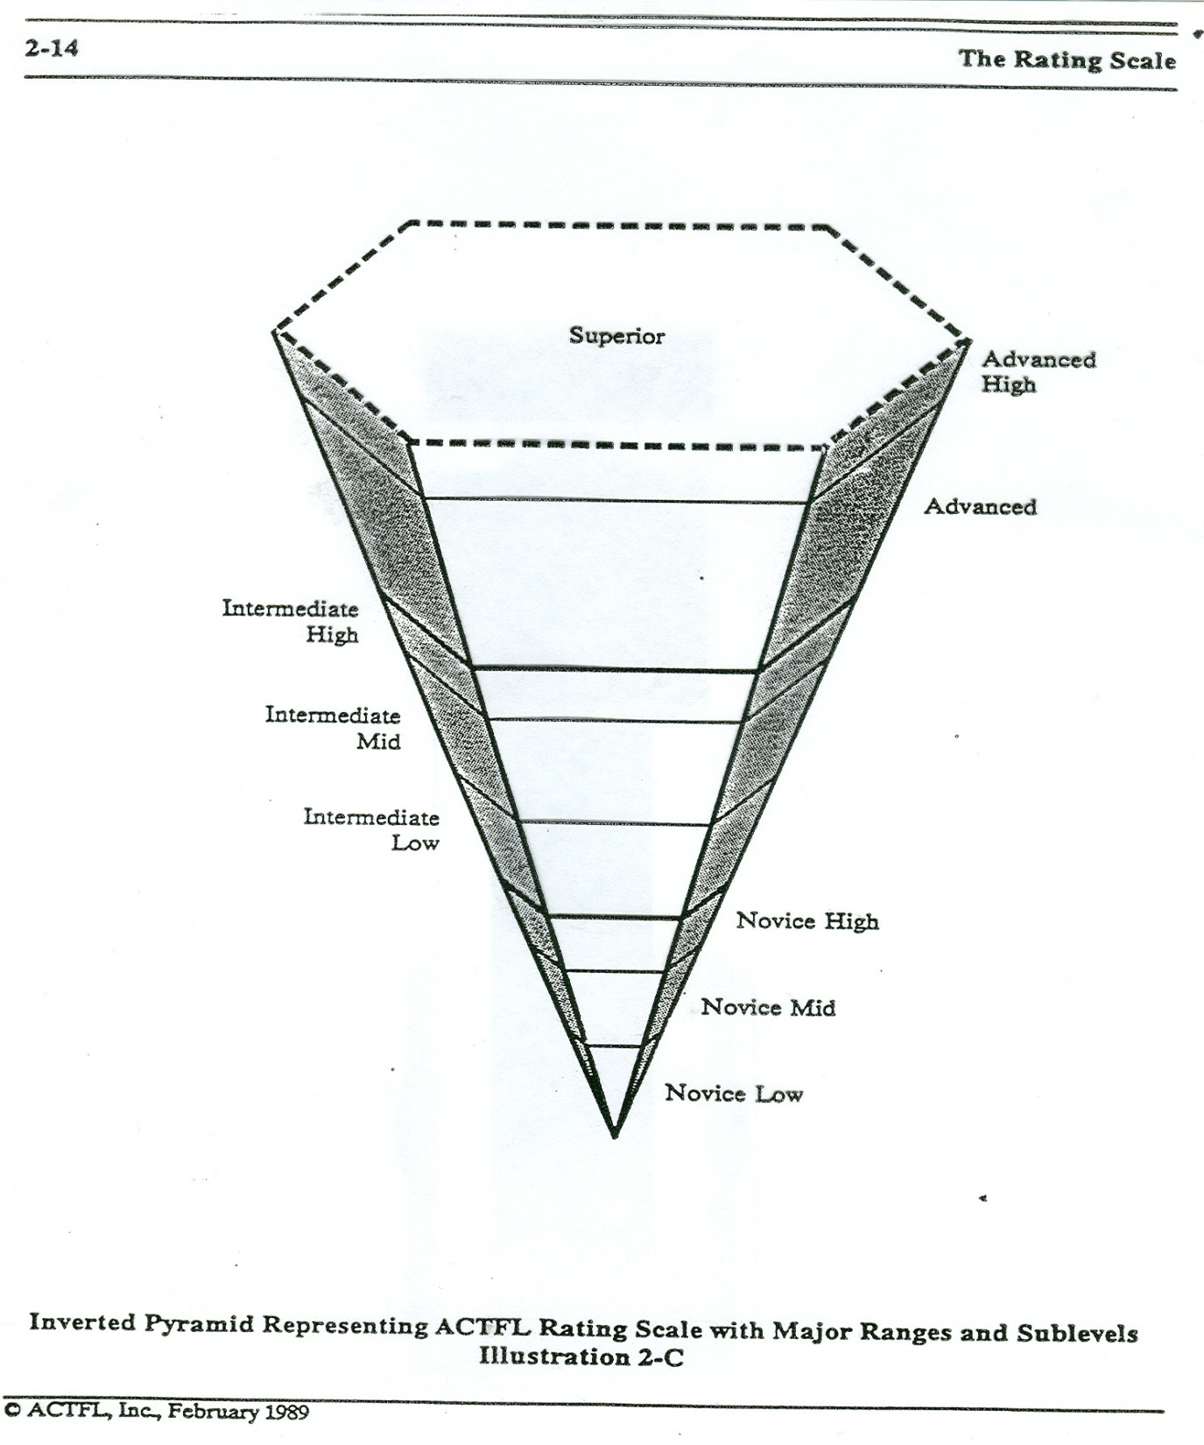

Slide 9
http://www.glastonburyforeignlanguage.org/curriculum/rubrics

Slide 10
Essential Questions: Grades 1-3 (Spanish)
Grade 1 | Grade 2 | Grade 3
How do we name things in a different language? Me What is my name? What are my body parts named? How old am I? What color are my eyes/hair? How do I greet others? Family How do I call the people in my family? How many people are in my family? What color are their eyes and hair? Animals What are animal sounds? What colors are the animals? What are their names? In what weather do they live? Monthly celebrations What do I celebrate? What do we celebrate? What is celebrated in Spanish speaking countries and around the world? What colors represent each holiday? What is the weather during these celebrations? How do I celebrate….(by months?) | Who are my neighbors? Me Who am I? What do I look like? What do I wear? Description of “self”, physical and emotional Friends and Family Who is in my community? People, at home/school/play, family, friends, leisure Neighbors Near & Far What are Mexico and Canada like? People, clothing, weather of Mexico and Canada Compare with each other and U.S.A. Animals Insects, Farm Animals, Pets What are their sounds and movement? | Why is my day the way it is? Is it different from other countries? Purpose What is school for? Learning, Socializing, Organizing Family How is my family different from others? My family, families in Ghana, Japan, China and the U.S.A. Food What do I eat and what do other children eat in Ghana, Japan, China and the U.S.A? Food in Ghana, Food in Japan, Food in China Food in U.S.A. (“el super sandwich”)

Slide 11

LINKS
Project AERO Website: http://www.projectaero.org/
AERO Model WL Curriculum in Atlas Rubicon: https://overseasschools-public.rubiconatlas.org/Atlas/Browse
World Language Live Binders: https://www.livebinders.com/b/2418396

Slide 12
Welcome to the AERO WL Day
GoalGoaGoals for today:
Review
- Standards, benchmarks, essential questions, assessments, model units etc.
Refocus
-How can the use of these tools help you in your schools?
Reframe
-With whom can/should you advocate in your school to help clarify how these units are different from what you might have used in the past?
Rethink
-How can you as a teacher, department, grade level or school modify these units for your own purposes?

Slide 13
ASSESSMENT AND WHY IT IS ESSENTIAL IN WORLD LANGUAGE INSTRUCTION
Presenters:
Dr. Elvira Swender
Dr. Neus Figueras
Dr. Jennifer Dobberfuhl Quinlan,
Dr.Christine Brown, Regional Education Officer and AERO Project Chair, US Department of State

