Slide 1
Inclusive Instructional Coaching:
Working with TAs to impact SEND learners
Nikki Sullivan becnls@beckfoot.org @Nikki__Sullivan @BeckfootTL
www.linkedin.com/in/nikki-sullivan-tandl/
11.30am – 1pm
5th NOVEMBER 2022

Slide 2
Coaching logistics & active ingredients…
1) Intended for all, but never managing to be for everyone.
2) Cycling round the same knowledge about teaching and learning.

Slide 3
Ambitions
Strong foundations
Active Ingredients
Core and Culture
Know thy impact

Slide 4
1) It starts with an ambition… What are our ambitions for staff professional development?

Slide 5
Dream it…
In terms of professional development, what do we want for our staff or ourselves?

Slide 6
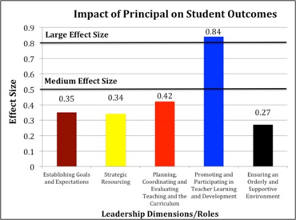
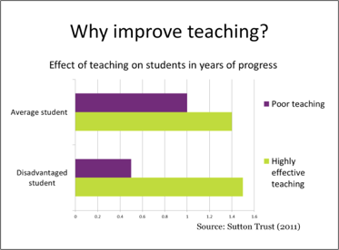
Firstly… transformative for students
Source: Robinson (2007)
Source: Sutton Trust (2011)

Slide 7
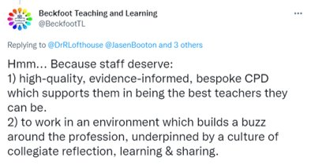
Secondly but not second place…
Transformative for staff

Slide 8
Best for our students… Best for and from our staff.
We need to provide prioritised and protected time and resources.
Not only this, our staff as individuals, as professionals,
deserve and are entitled to this investment.

Slide 10
What is Instructional Coaching?
‘GROW Model’ or ‘Executive Coaching’
With the ability to ‘flex’
‘Mentoring?’

Slide 11
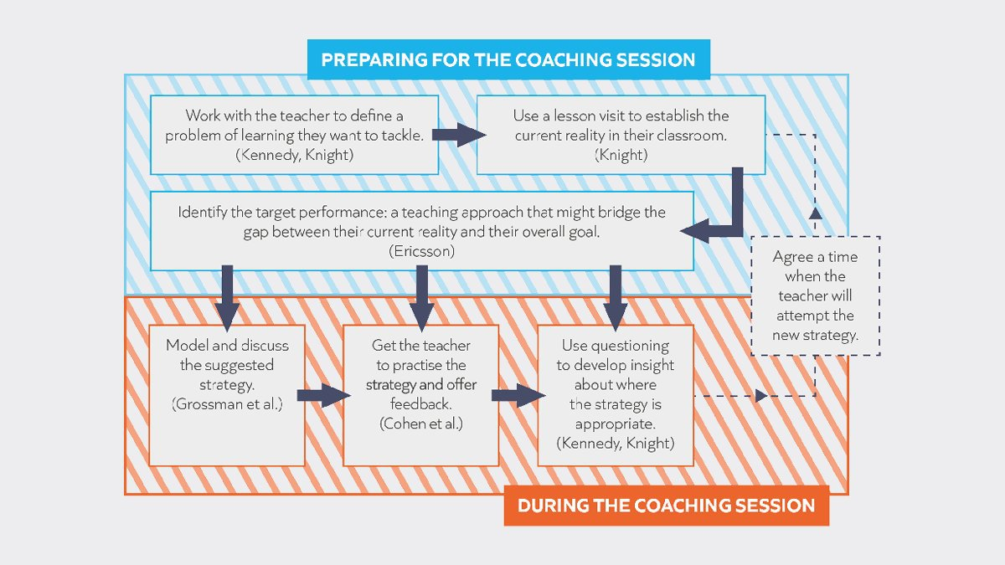
What is Instructional Coaching? | Ambition Institute

Slide 12
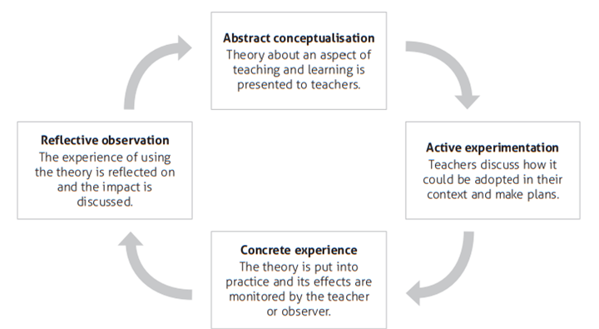
Kolb plus Korthagen
Kolb from: Enser, M., Enser, Z. (2021). The CPD Curriculum: Creating Conditions for Growth. United Kingdom: Crown House Publishing.
Full article: Inconvenient truths about teacher learning: towards professional development 3.0 (tandfonline.com)

Slide 13
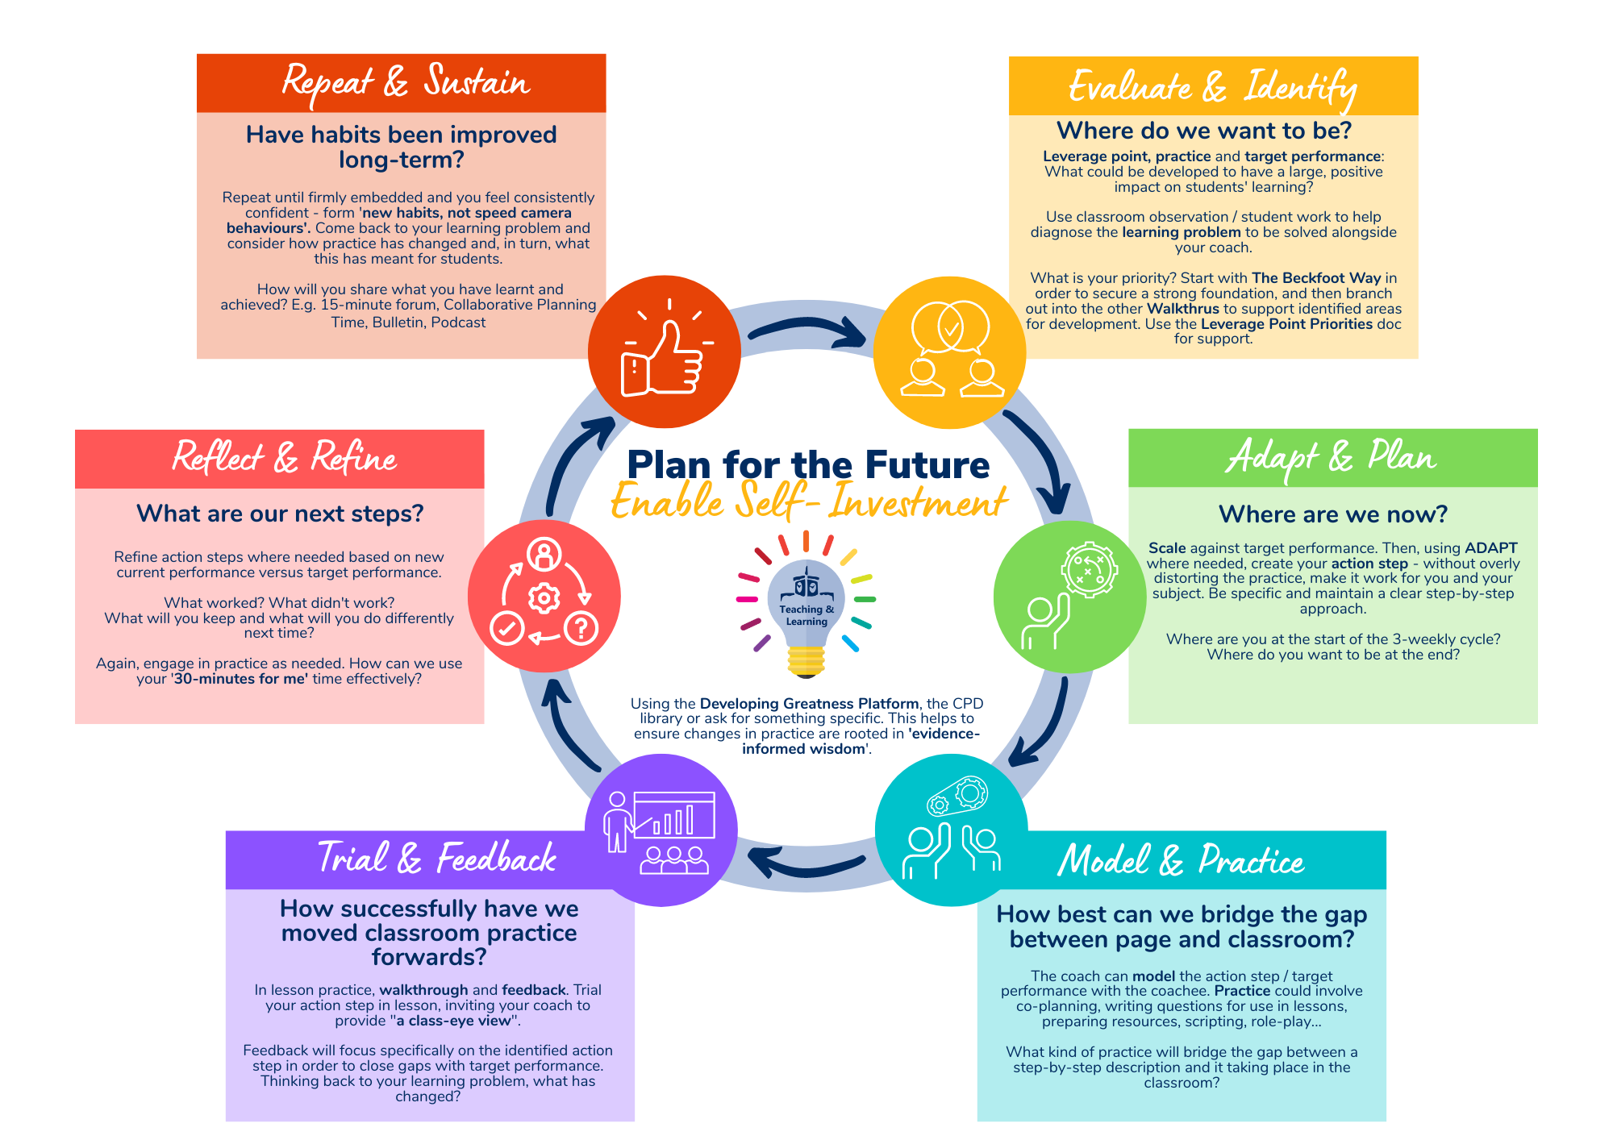
Not full-time coaches…

Slide 14
Resources to support

Slide 15
It starts with an ambition… What are our ambitions for staff professional development?

Slide 16
Equitability
Cost
Impact
Human-centred

Slide 17
2) It builds with a contextual foundation… What needs to be in place to enable successful coaching for all?

Slide 18
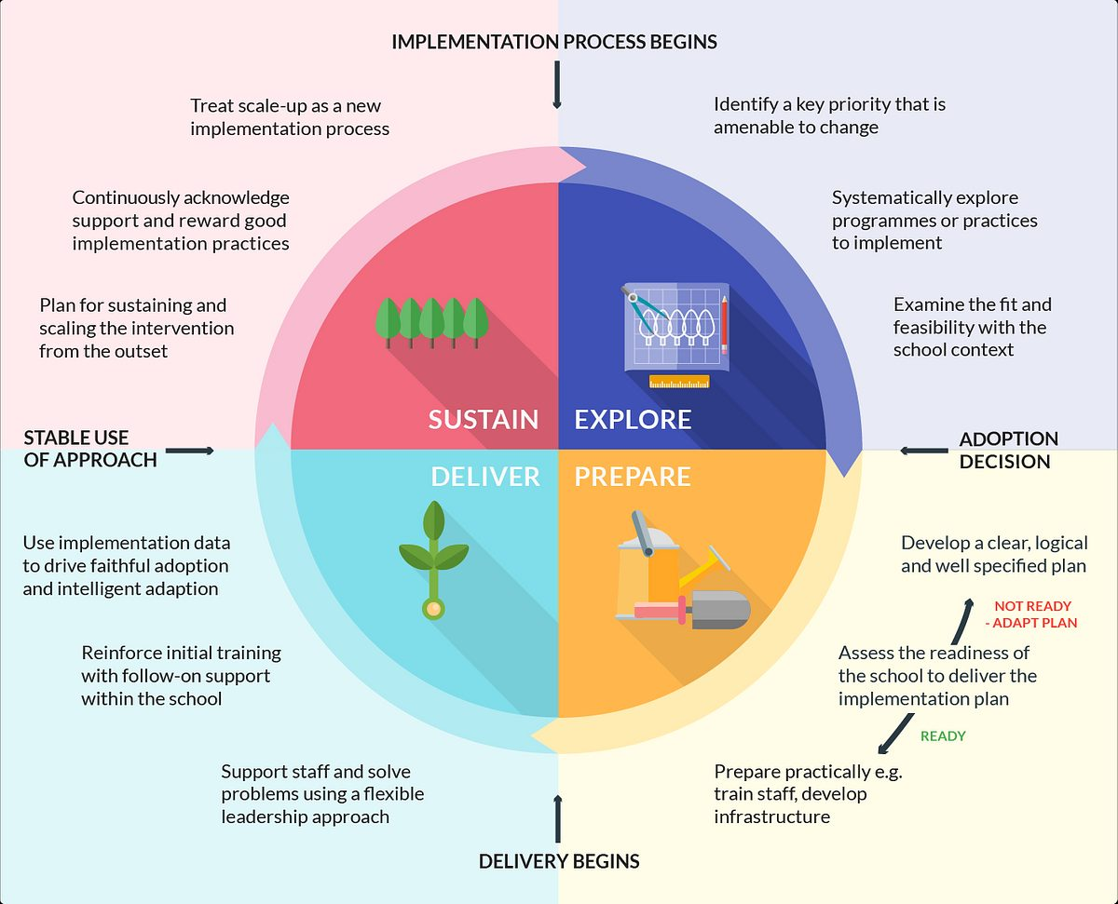
Explore and prepare…
What needs to be in place to enable successful coaching for all?
Putting Evidence to Work - A School’s Guide to Implementation | EEF (educationendowmentfoundation.org.uk)

Slide 19
“Implementation Challenges…”
Professional Culture
How can we develop a culture of openness to feedback and commitment to ongoing development?
Coaching: 4 Implementation Challenges And How To Defuse Them | Steplab

Slide 20
1) Professional Culture
teaching assistant
“Every teacher needs to improve, not because they are not good enough, but because they can be even better.”
Source: Dylan Wiliam

Slide 21
1) Professional Culture
“What did questioning look like at Beckfoot School?”

Slide 22
1) Professional Culture
Making Best Use of Teaching Assistants | EEF (educationendowmentfoundation.org.uk)

Slide 23
“Implementation Challenges…”
Professional Culture
Training
How can we develop a culture of openness to feedback and commitment to ongoing development?
How can we recruit and train a team of skilled, knowledgeable coaches?
Coaching: 4 Implementation Challenges And How To Defuse Them | Steplab

Slide 24
2) Training
Who?
SENDCo
Assistant SENDCo
3 x HLTAs

Slide 25
2) Training
Who?
What?
SENDCo
Assistant SENDCo
3 x HLTAs

Slide 27
2) Training
Who?
What?
SENDCo
Assistant SENDCo
3 x HLTAs
Contracting
Mental Models of being an effective TA
Scaling
Modelling & Practice
Observing
Feedback

Slide 28
2) Training
Who?
What?
How?
SENDCo
Assistant SENDCo
3 x HLTAs
Contracting
Mental Models of being an effective TA\
Scaling
Modelling & Practice
Observing
Feedback
Existing policy
Initial training
Initial practice
Initial co-observation
Ongoing CPD
Helen Morgan

Slide 29
“Implementation Challenges…”
Professional Culture
Training
Systems design
How can we develop a culture of openness to feedback and commitment to ongoing development?
How can we recruit and train a team of skilled, knowledgeable coaches?
Coaching: 4 Implementation Challenges And How To Defuse Them | Steplab
How should we structure our programme so that it delivers results in a way that balances with other school systems, and delivers efficiency?

Slide 30
3) Systems Design
Teachers
Teaching Assistants
3-weekly cycle
2-weekly cycle
Collaborative Planning Time
Best Practice Time
Policy first leverage points
Policy only leverage points
Teacher informed
Team informed
Pairs
Trios
In the teacher’s classroom
In one room together

Slide 31
“Implementation Challenges…”
Professional Culture
Training
Responsive Leadership
Systems design
How can we develop a culture of openness to feedback and commitment to ongoing development?
How can we recruit and train a team of skilled, knowledgeable coaches?
Coaching: 4 Implementation Challenges And How To Defuse Them | Steplab
How should we structure our programme so that it delivers results in a way that balances with other school systems, and delivers efficiency?
How can we gather information about what’s happening when our programme is up and running?

Slide 32
4) Responsive Leadership
Being in the coaching meetings
The coaching logs
Staff voice
Walkthroughs
Quantity, Quality

Slide 33
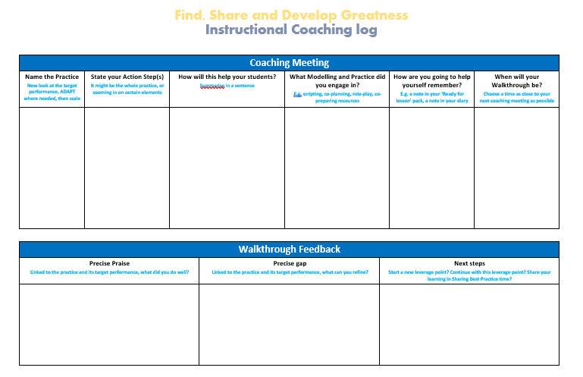
4) Responsive Leadership

Slide 34
4) Responsive Leadership
Being in the coaching meetings
The coaching logs
Staff voice
Walkthroughs
Quantity, Quality, Buy-in, Impact

Slide 35
3) It’s successful when we focus on active ingredients… What does coaching need to include in order to have impact?

Slide 36
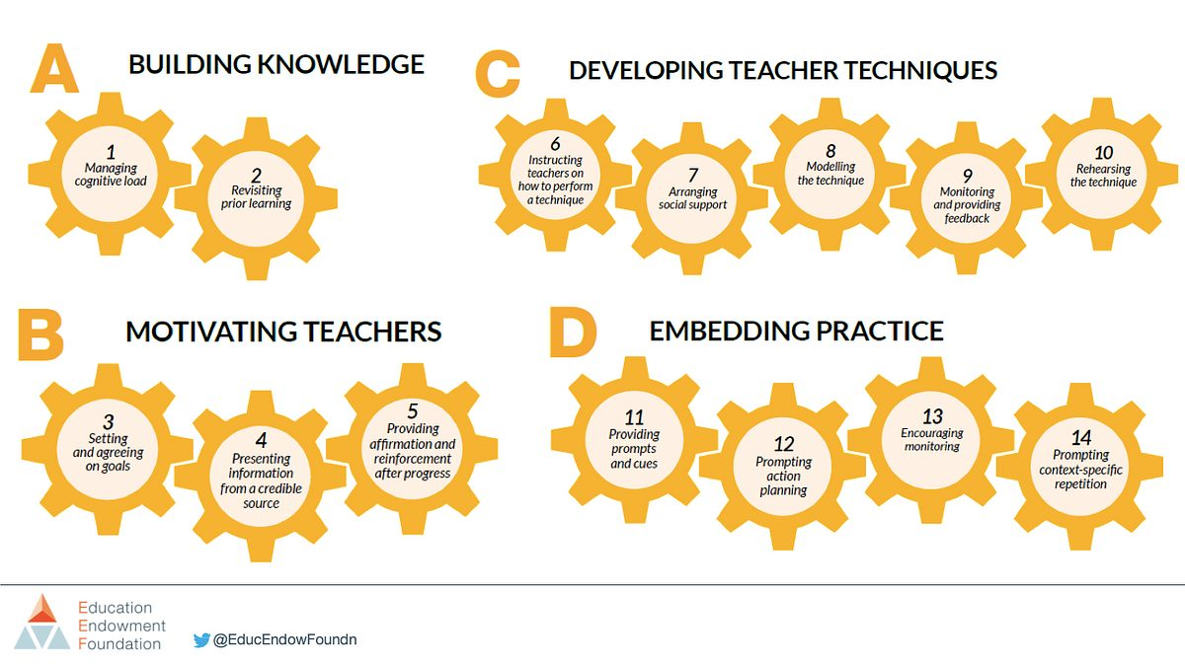
It’s all in the mechanisms…
Effective Professional Development | EEF (educationendowmentfoundation.org.uk)

Slide 37
Map it…
Which mechanisms do we see in a coaching model?

Slide 39
Zooming in… 3 areas to consider

Slide 41
Evaluate and Identify
What are the most common ‘learning problems’ we come across?

Slide 42
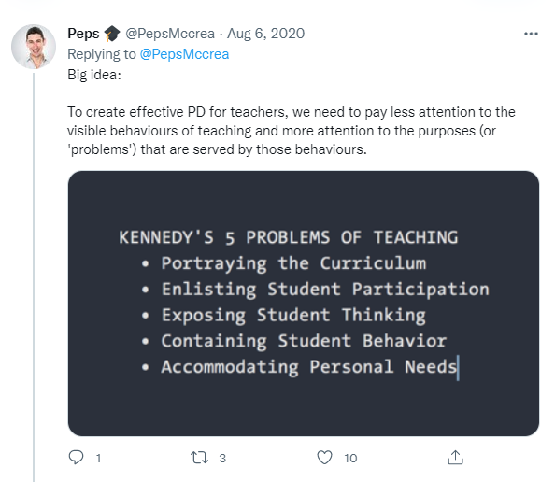
Evaluate and Identify

Slide 43
The importance of a common language
“Creating a common language and vocabulary for key teaching and leadership practices is of fundamental importance in making the most of professional development. […] if framing is not used correctly, there can be multiple understandings of a single topic. Moreover, we cannot talk to each other effectively.”
Bambrick-Santoyo, Leverage Leadership, 2012, p. 148

Slide 44
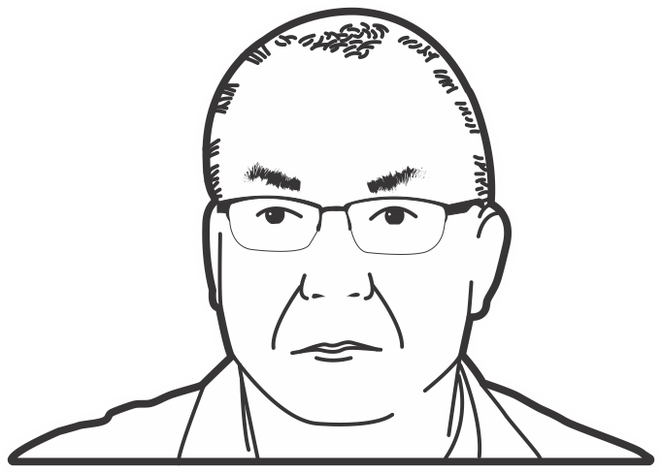
Playbook | Necessary – additions and adaptations to match your policy
Instructional coaches run the risk of being inefficient if they don’t have a repertoire of effective practices to share with teachers.
INSTRUCTIONAL COACHING, P.177
JIM KNIGHT

Slide 45
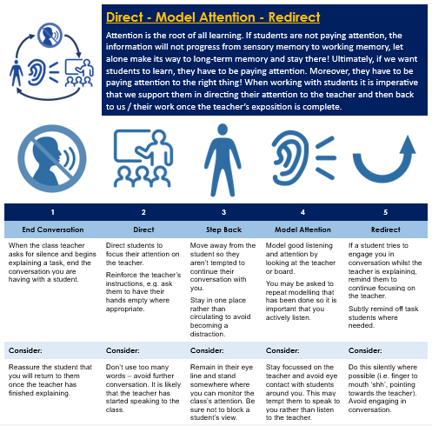
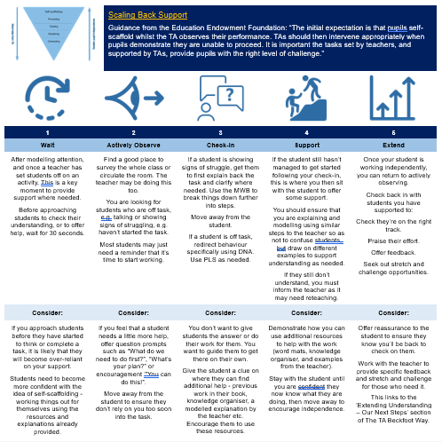
Creating our own ‘playbook’

Slide 47
Adapt and Plan
Why is it so important that teachers and TAs get to consider practices in context?

Slide 48
Adapt and Plan
Different subjects
Different students
To strengthen mental models
To avoid using the wrong practice at the wrong time
Autonomy and not having teacher clones

Slide 49
Target Performance
The first step is to identify a destination or outcome, often called the target performance.
Teachers can move from their current performance towards this target performance by practising a sequence of sub-goals with the aid of a coach. This allows them to overcome existing ingrained habits and adopt new behaviours.
Steve Farnden, What is Instructional Coaching? | Ambition Institute

Slide 50
Jim Knight | Scaling – fine-tuning existing practices, e.g. Show Me Boards

Slide 51
Action Steps
“The heart of this model is the action step, a specific, 'granular' change to a teacher's practice. This is influenced by the popularity of the Teach Like a Champion approach, where the 'moves' of teaching are front and center in teacher development (Lemov, 2015)”
“"The most successful leaders I've worked with give feedback in this way: they observe teachers frequently and assign them just one or two action steps per week. It feels excruciatingly slow at first...but little by little, the steps build momentum..." (Bambrick-Santoyo, 2016)”
What Do We Mean When We Talk About Instructional Coaching? | Steplab

Slide 53
Model and Practice
Why are modelling and practice, outside of the classroom environment, active ingredients?

Slide 54
Model and Practice
See it in action
Lesson ready
Cognitive load
We’re really busy – get ready now or possibly never!
FLEX, e.g. our FL for Science

Slide 55
Modelling (not always performative) & Practice
“Great teaching is not learned through discussion. It’s learned by doing – or, more specifically, by practicing doing things well. Supervised practice, then, is the fastest way to make sure all teachers are doing the right things”
Bambrick-Santoyo, Leverage Leadership, 2012, p. 86
“If a surgeon simply tells a resident how to perform an operation, the resident will be less effective than if she practices with the surgeon's guidance. Teaching is the same: practicing implementation of the feedback with the leader is at the heart of speeding up the improvement cycle.”
Bambrick-Santoyo, Leverage Leadership, 2012, p. 79

Slide 57
4) This might be our core, but what more about culture? How else do we build a culture of professional learning?

Slide 58
Enrich it…
How else can we build a culture of professional learning?

Slide 59
Culture, culture, culture
Evidence-informed
Collegiate
Leadership
Celebration
Bulletins
Briefings
Best Practice sessions
Paid attendance at training days
Faculty Research Leads
Becoming a coach
Wonderwalls
With each leverage point

Slide 60
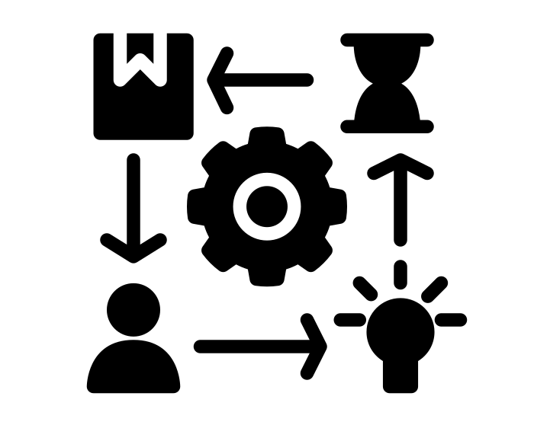
5) “Know thy impact” What have we learnt along the way? What are our next steps?
Source: John Hattie

Slide 61
Zooming in…
Strengthening Coaching – Love to talk Teaching and Learning (wordpress.com)
Strengthening Coaching
Instructional Coaching for all teachers
Broadening Coaching
Instructional Coaching for all TAs
Coaching for all
Coaching for all staff
3-weekly cycle in directed time (Year 3 onwards)
Focus in on the active ingredients
2-weekly cycle in directed time
Focus in on the active ingredients
Cyclical approach through line management?
Carefully considering a core of active ingredients
Strong evidence base

Slide 62
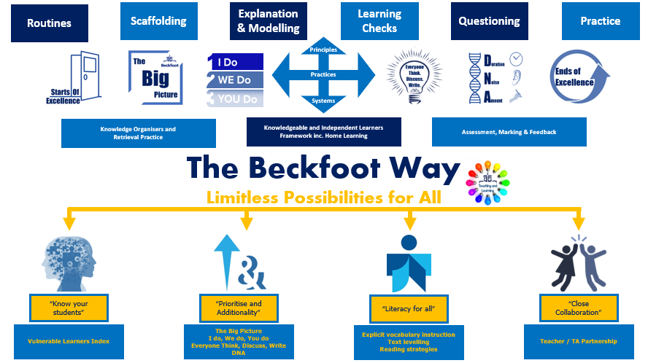
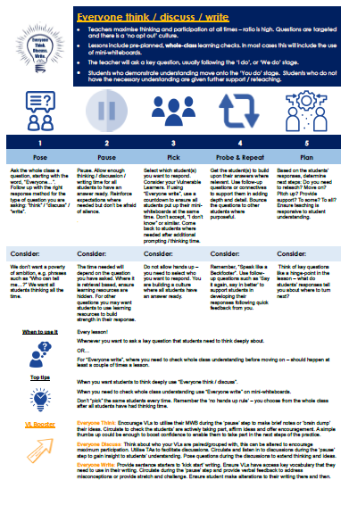
Vulnerable Learners at the heart of what we do

Slide 63
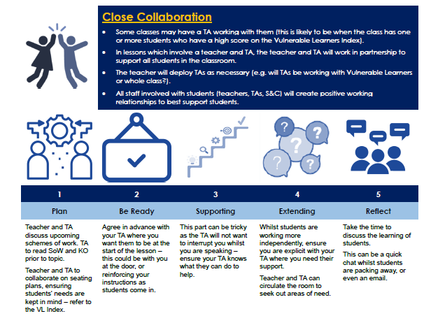
Teacher / TA relationships

Slide 64
Shoots of impact
Staff Voice
95% of staff believe that leaders make appropriate provision for their PD.
Retention
100% of staff are proud to work at Beckfoot School.
Outcomes for students
Best ever outcomes, including for students with SEND, 2022.

Slide 65
Next Steps
Fewer coaches for teachers?
Increase expertise of TA coaches.
Continue to build our TA playbook.
Ensure cumulation of good practice / habits.
Succession planning and ‘Faculty Research Leads’.
Training up new TA coaches. Mirroring our Coaches CPD for teaching staff with an induction and ongoing model.

Slide 66
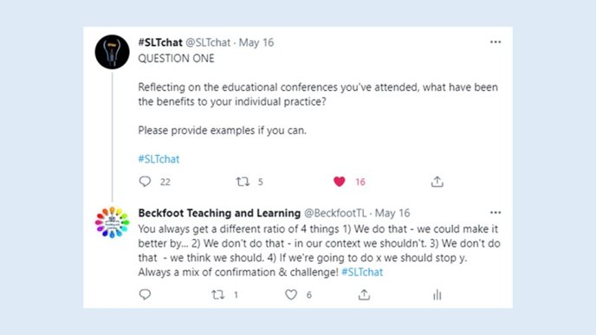
becnls@beckfoot.org
@Nikki__Sullivan
@BeckfootTL
www.linkedin.com/in/nikki-sullivan-tandl/
Nikki Sullivan

