Slide 1
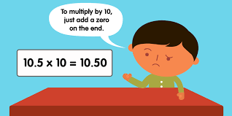
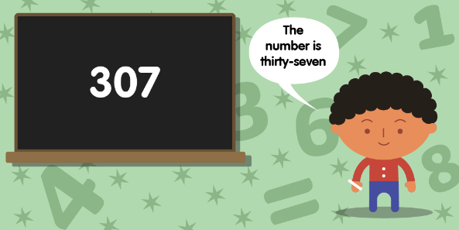
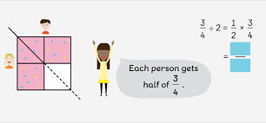
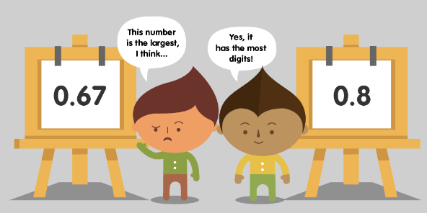
Identifying Math Misconceptions in
Virtual / Hybrid Classrooms
REBECCA MURRY
1130 - 1300
05 NOVEMBER 2022

Slide 2
TIME TABLE FOR WORKSHOP
1130 – 1145 - What is Mathematical Reasoning? Can we achieve this in a Hybrid Math Classroom?
1145 – 1200 – Sample Scene of a Hybrid Math Classroom #1
1200 - 1215 – Discuss observations and use the Padlet to share formative assessments
1215 – 1230 – Fraction Hybrid Classroom #2: Number Strings
1230 – 1245 – Are Open-ended Word Problems Relevant in Virual Classrooms?
1245 – 1300 – Participants group together and try out one of the sample problems to use for a Hybrid lesson – design the lesson with a breakout session and a share/closure

Slide 3
What is Mathematical Reasoning? Can this be done in a Hybrid Classroom?
MP1 / MAIN GOAL FOR STUDENT SUCCESS:
MAKE SENSE OF PROBLEMS AND PERSEVERE IN SOLVING THEM
MP 2: REASON ABSTRACTLY AND QUANTITATIVELY
MP3 Contruct Viable Arguments and critique the reasoning of others
MP 4 Model with Mathematics
MP 5 Use appropriate tools strategically
MP 6 Attend to precision
MP 8: LOOK FOR AND EXPRESS REGULARITY IN REPEATED REASONING
MP3 Contruct Viable Arguments and critique the reasoning of others
MP 4 Model with Mathematics
MP 5 Use appropriate tools strategically
MP 6 Attend to precision
QUANTITIES & RELATIONSHIPS
REPETITION
STRUCTURE
MP 7: LOOK FOR AND MAKE USE OF STRUCTURE
MP3 Contruct Viable Arguments and critique the reasoning of others
MP 4 Model with Mathematics
MP 5 Use appropriate tools strategically
MP 6 Attend to precision
Notes:
Reference: Routines for Reasoning
The Common Core’s 8 Standards for Mathematical Practices are just as important as the Content STandards themselves, but they hold weight when it comes to children’s Mathematical Reasoning. All 8 are important and there is no real hierarchy to the way they are numbered, however, how to begin to incorporate them into our teaching practice can be daunting. Specific practices, which we shall call SMPs have important value for Mathematical Thinking in a classroom. This is especially true for Virtual / Hybrid Classrooms. The LEAD ACTORS are MP 1, then MP 2, MP 7, and MP 8 are critical to developing mathematical reasoning. The other 4 bullets are critical supports to

Slide 4
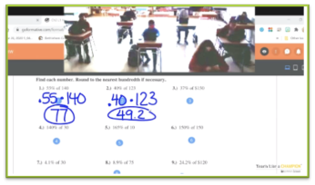
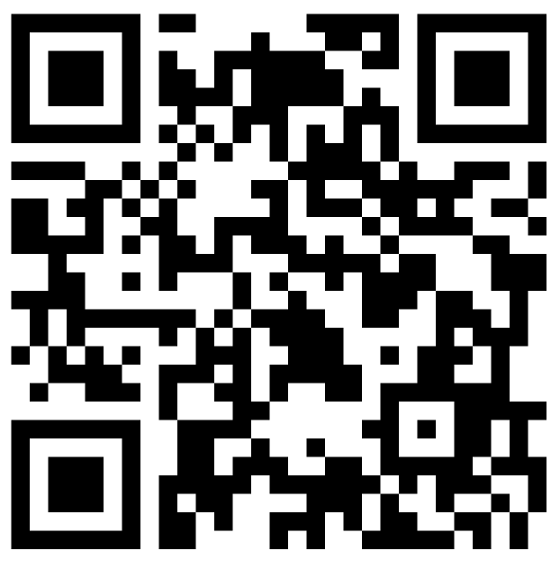
What is Mathematical Reasoning like in one Hybrid Math Classroom? Can Misconceptions be identified if Reasoning is not emphasized?
Observe the video sample of a 7th grade grade Hybrid math classroom
PADLET SURVEY

Slide 5
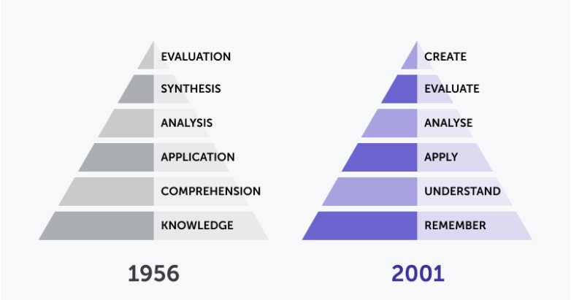
Revised Blooms Taxonomy 1956 to 2001

Slide 6
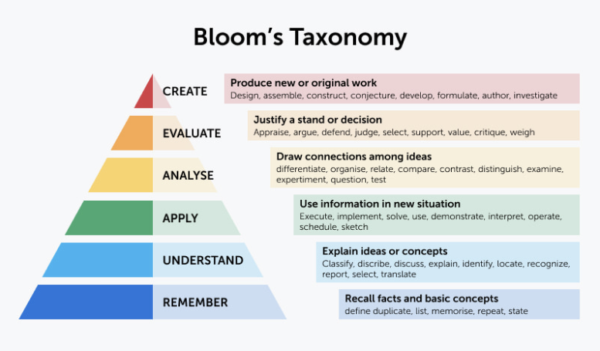
Revised Blooms Taxonomy

Slide 7
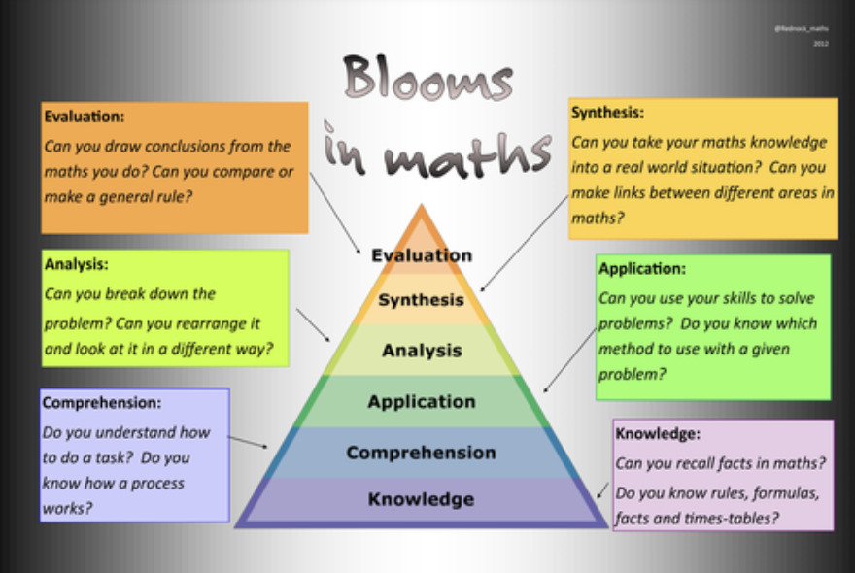
What does Blooms Taxonomy Look like in a Math Classroom?
Is it different for Face-to-Face vs Hybrid?
https://www.forbes.com/sites/kevinanderton/2019/04/28/the-misconceptions-about-math-that-are-keeping-students-from-succeeding-infographic/?sh=c572cd04dd98

Slide 8
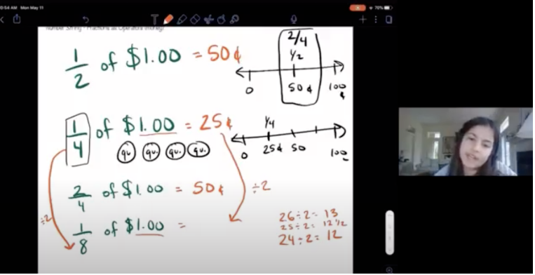
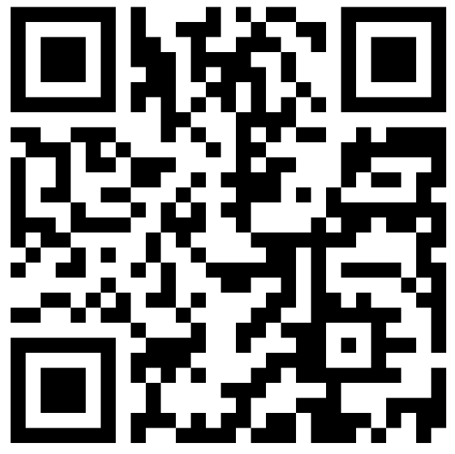
Fraction Hybrid Classroom #2: Number Strings
PADLET SURVEY

Slide 9
SAMPLE LESSONS TO TRY TWEAKING FOR HYBRID!
How can we identify misconceptions using simple number problems?
NUMBER STRINGS

Slide 10
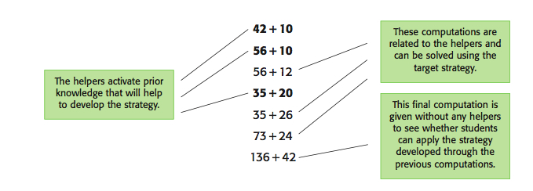
Structure of a Number String for Hybrid Lesson

Slide 11
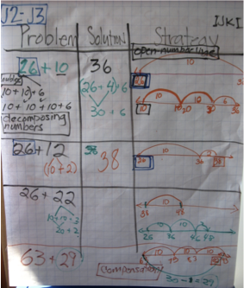
SAMPLE LESSON IN GRADE 2
Trial 1
26 + 10
26 + 12
26 + 22
44 + 30
44 + 29
22 + 58
63 + 29

Slide 12
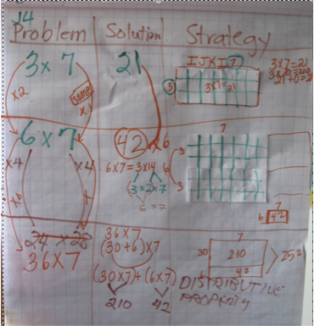
SAMPLE LESSON IN GRADE 4
Trial 2
3 x 7
6 x 7
36 x 7
18 x 14
28 x 14
28 x 18
56 x 36

Slide 13
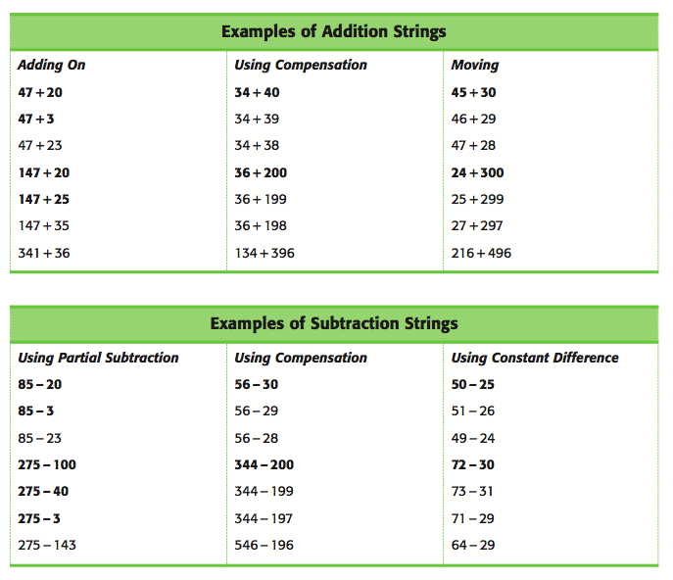
Number Strings in Hybrid
Trial 3

Slide 14
SAMPLE LESSONS TO TRY TWEAKING FOR HYBRID!
How can we identify misconceptions using technology?
USING LEARNING ADAPTIVE TECHNOLOGY

Slide 15
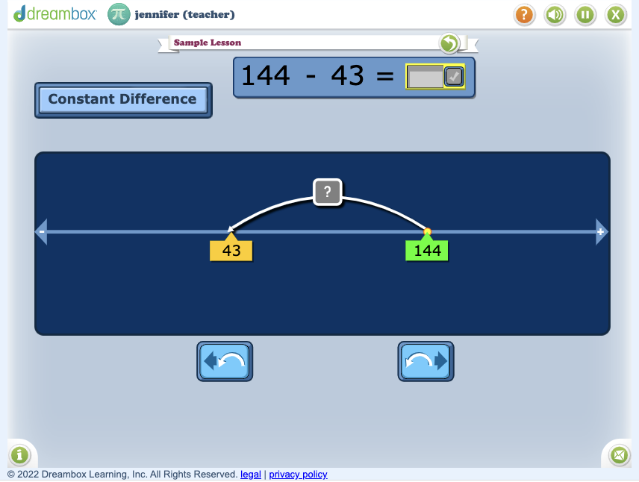
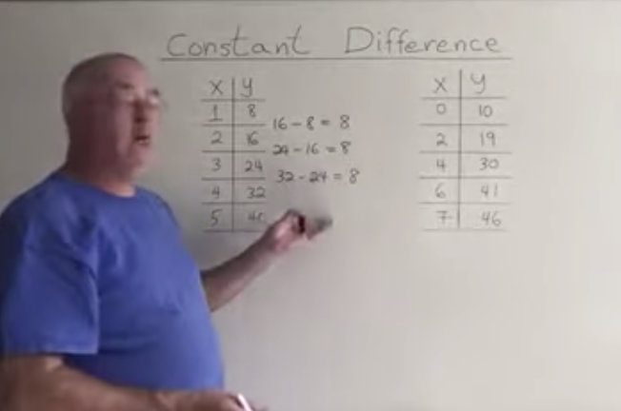
Learning Adaptive Technology in Hybrid Classrooms
Trial 4
CONSTANT DIFFERENCE
Constant difference refers to the idea that the difference between two numbers does not change after adding or subtracting the same quantity to both numbers.

Slide 16
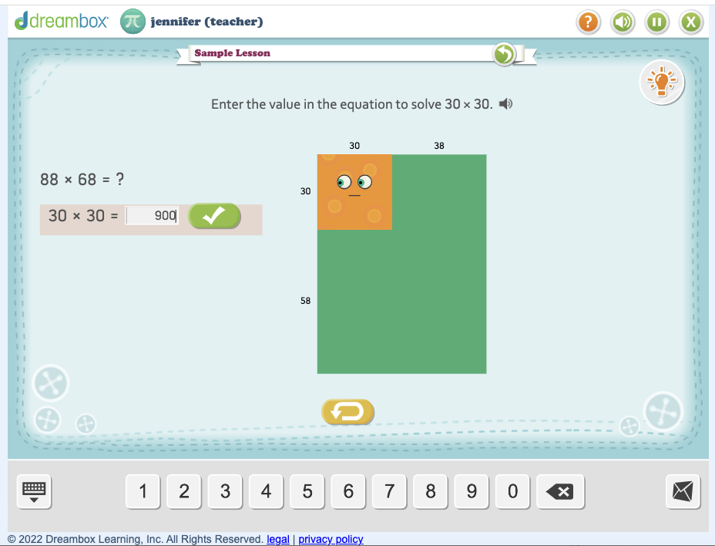
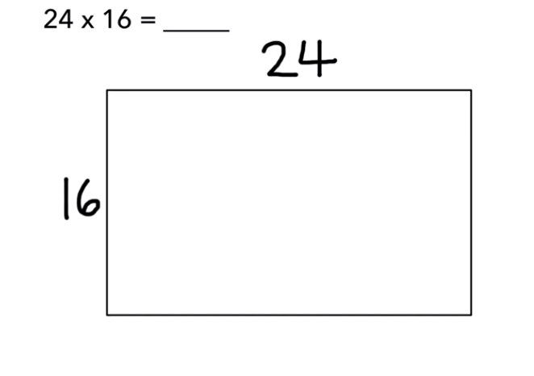
Learning Adaptive Technology in Hybrid Classrooms
Trial 4
OPEN ARRAYS
Arrays are useful models for multiplication which can be used in a variety of ways, ranging from highly structured lessons to games and open investigations.

Slide 17
Are Open-ended Word Problems Relevant in Virtual / Hybrid Classrooms?
Grade Level | Open Ended Problem Samples by Grade For Break-out Rooms
3-4 | Crosswords are fun to figure out, but much more to create: Create a crossword puzzle on the given grid in Google Doc, using addition,subtraction, multiplication, and division clues. After, share in a Breakout Room!
5 | Medical experts have recommended that everyone walk at least 10,000 steps a day to stay healthy. How far do you walk in a day during Hybrid? Do you meet the 10,000 steps a day guideline? Chart your walk for 5 days of the week you are in Hybrid! Then figure out if you were to continue given that number of steps, how much would you walk in a month’s worth of Hybrid !!! Share on Friday’s Breakout Room
6 | Is it possible to make all numbers between 1 and 100 by using 4 fours using all the operations? Example 4 divided by 4 + 4 - 4 = 1 Make as many of the numbers between 1 and 100 in this way to see if it is possible! Hint: Would using the Parenthesis be useful in some situations?
7-8 | Describe in your Breakout Room “100 thousand in as many ways as possible” (NO LESS THAN 20 ways)

Slide 18
TYPICAL MATH MISCONCEPTIONS BY GRADE LEVEL IN HYBRID
Grade Level | MATH MISCONCEPTIONS | VIRTUAL / HYBRID SUPPORT & ANCHORS
3-4 | Misconception: Multiplication and Division are unrelated to each other | TRUE: Multiplication undoes division and division undoes multiplication - Inverse Operations same as Addition is to Subtraction Support: Focus Breakout room Discussions about this and have students present virtually how this can be proven visually
5-6 | Misconception: Multiplication: a FACTOR is a part of a multiplication sentence and a MULTIPLE is the answer to a multiplication problem When terminology is misused, misunderstanding happens | TRUE: Numbers multiplied are FACTORS The product is the MULTIPLE Support: Focus lessons on preventing the confusion. Have students design Learning Posters
7-8 | Misconception: PEMDAS Order of Operations No understanding of the Reasoning behind PEMDAS Multiplication ALWAYS occurs before Divison and Addition ALWAYS occurs before Subtraction | TRUE: To simplify an expression, perform the operation that has the greatest impact first Support: Problem posing always helps puts reality to PEMDAS so have students create a story out of -35 + -6 + 8.50(9) Jenny earns $8.50 an hour cat-sitting 3 cats. That afternoon, he took the cats on a stroller to the pet store and bought $35 worth of cat toys and $6 worth of Cat treats. If he cat-sat for 9 hours, how much money did he have left after he spent all that money at the pet store?

Slide 19
What is Mathematical Reasoning? Can this be done in a Hybrid Classroom?
MP1 / MAIN GOAL FOR STUDENT SUCCESS:
MAKE SENSE OF PROBLEMS AND PERSEVERE IN SOLVING THEM
MP 2: REASON ABSTRACTLY AND QUANTITATIVELY
MP3 Contruct Viable Arguments and critique the reasoning of others
MP 4 Model with Mathematics
MP 5 Use appropriate tools strategically
MP 6 Attend to precision
MP 8: LOOK FOR AND EXPRESS REGULARITY IN REPEATED REASONING
MP3 Contruct Viable Arguments and critique the reasoning of others
MP 4 Model with Mathematics
MP 5 Use appropriate tools strategically
MP 6 Attend to precision
QUANTITIES & RELATIONSHIPS
REPETITION
STRUCTURE
MP 7: LOOK FOR AND MAKE USE OF STRUCTURE
MP3 Contruct Viable Arguments and critique the reasoning of others
MP 4 Model with Mathematics
MP 5 Use appropriate tools strategically
MP 6 Attend to precision
Notes:
Reference: Routines for Reasoning
The Common Core’s 8 Standards for Mathematical Practices are just as important as the Content STandards themselves, but they hold weight when it comes to children’s Mathematical Reasoning. All 8 are important and there is no real hierarchy to the way they are numbered, however, how to begin to incorporate them into our teaching practice can be daunting. Specific practices, which we shall cann SMPs have important value for Mathematical Thinking in a classroom. This is especially true for Virtual / Hybrid Classrooms. The LEAD ACTORS are MP 1, then MP 2, MP 7, and MP 8 are critical to developing mathematical reasoning. The other 4 bullets are critical supports to

Slide 23
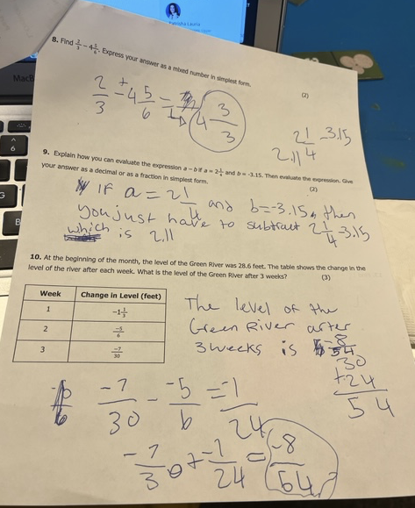
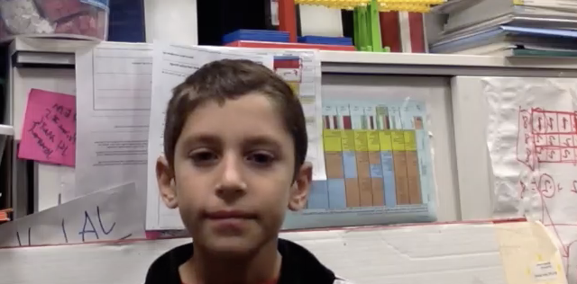
CONTACT : rmurry@unis.org
Access to Resources of this Presentation please email me your request.

Slide 24
CONTACT : rmurry@unis.org
Access to Digital Resources used for this Presentation

